Slide 1
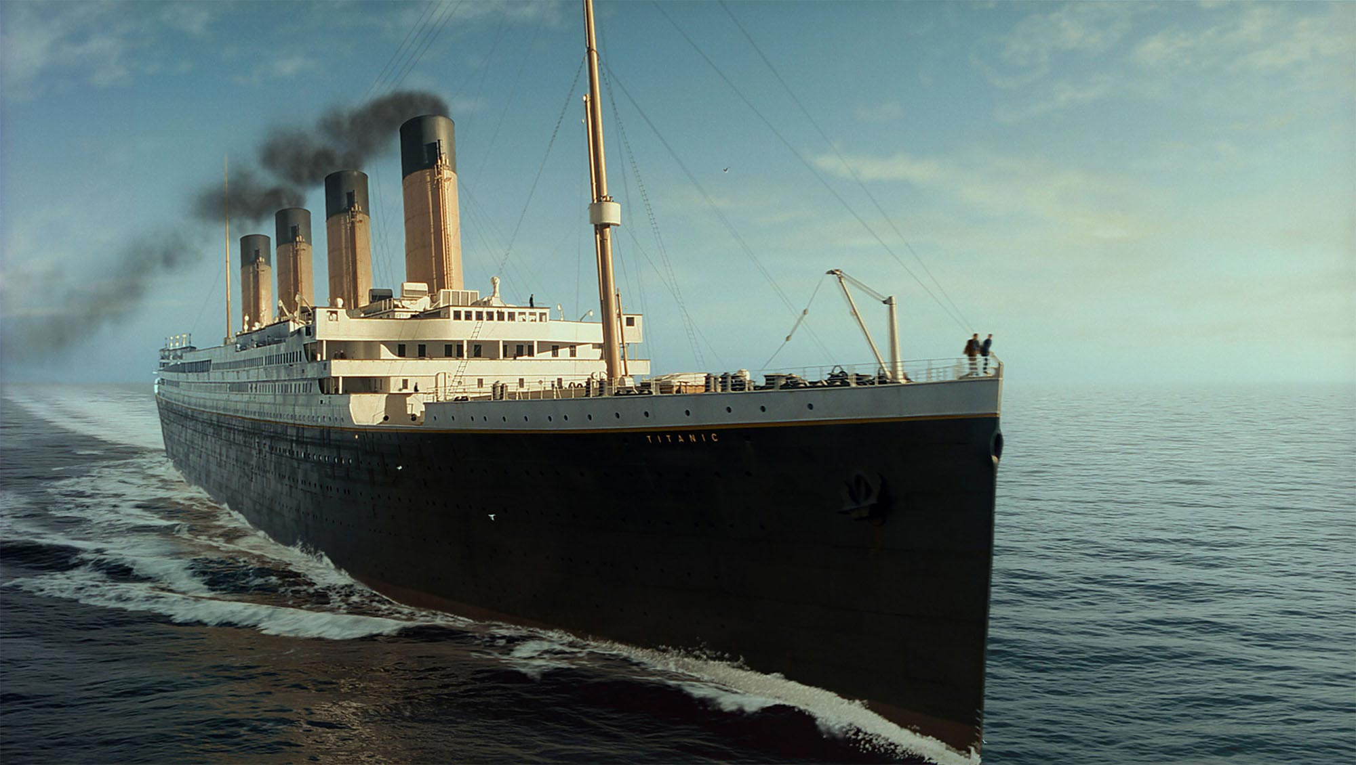
Titanic Survival
Prediction

Slide 2

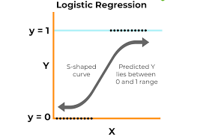
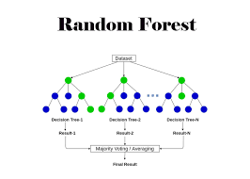
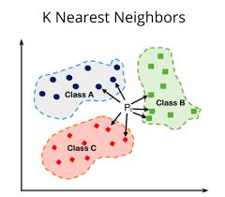
Overview
The objective of this project is to create a small and accurate ML model that predicts the survival of passengers aboard the Titanic.
We executed this in three stages:
Data Cleaning
Data Modelling ( see below )
Data Analysis

Slide 3
Data Cleaning

Slide 4
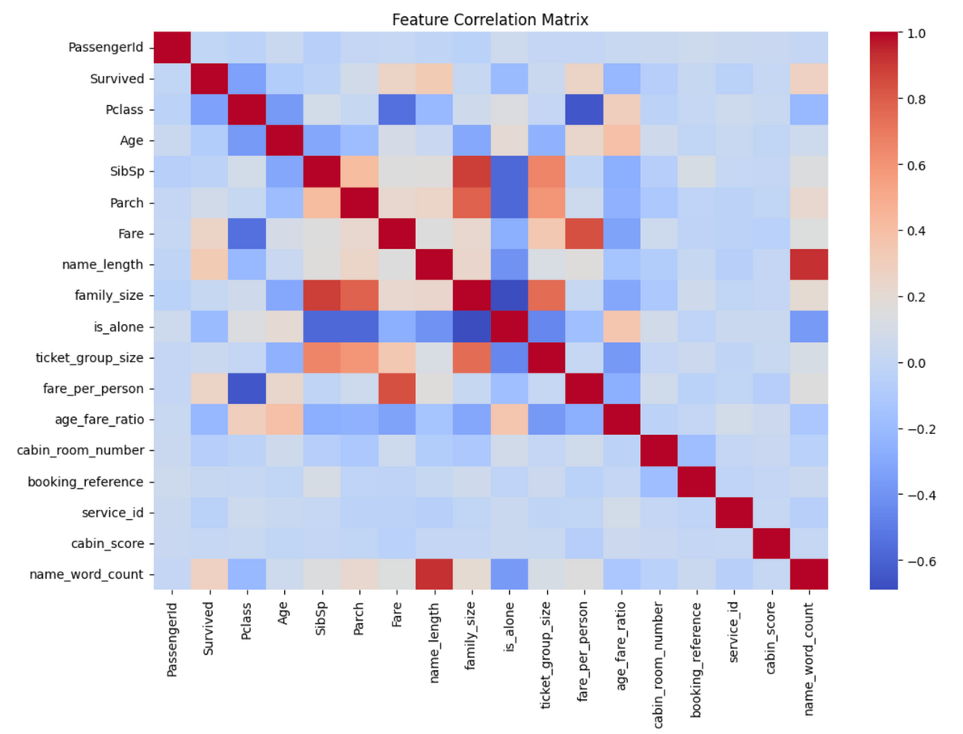
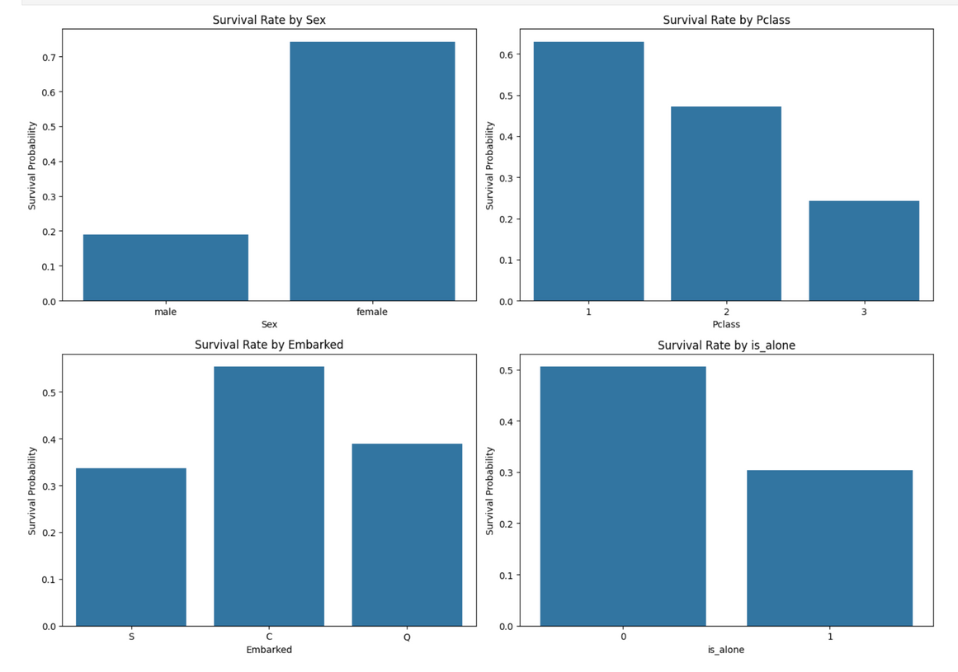
EDA

Slide 5
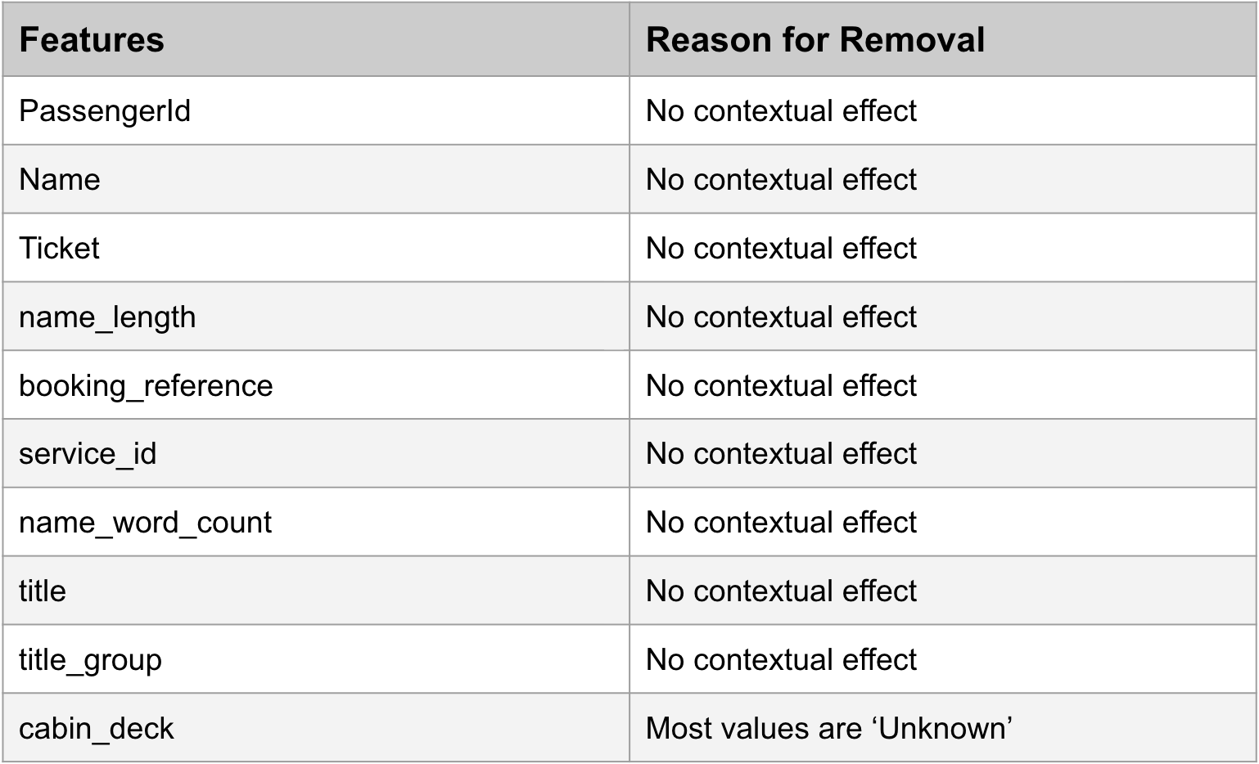
Feature Selection

Slide 6
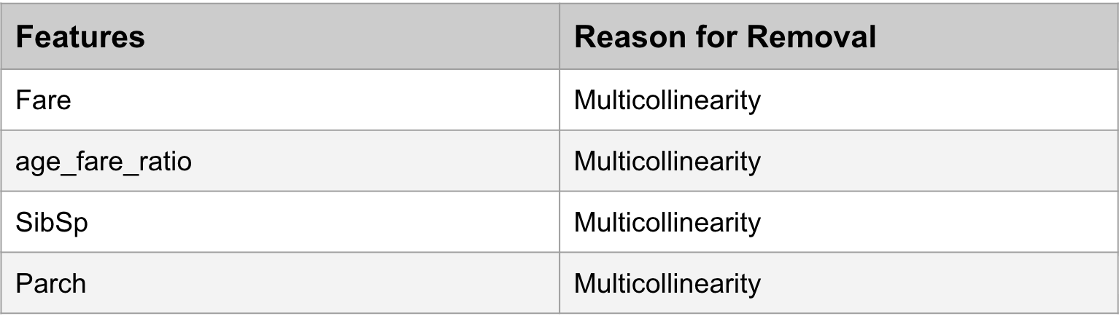
Feature Selection

Slide 7
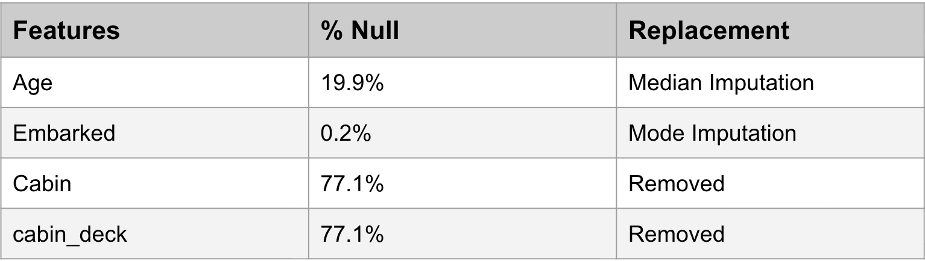
Handling Nulls

Slide 8
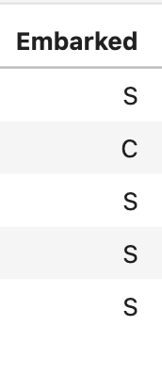
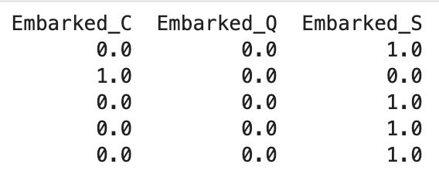

Categorical Encoding

Slide 9
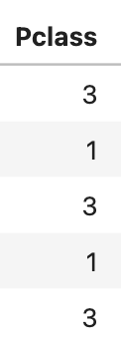
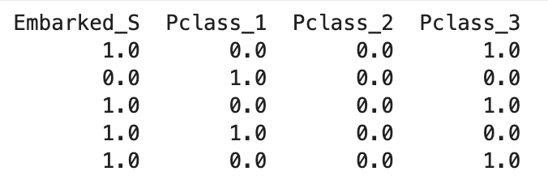
Categorical Encoding

Slide 10
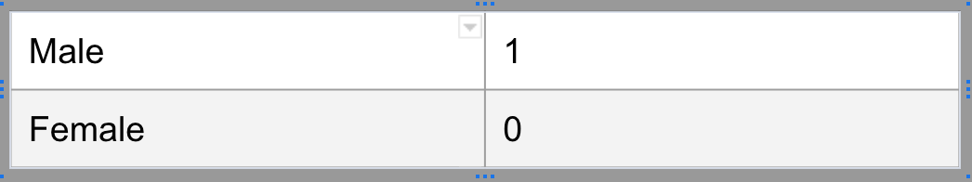
Categorical Encoding

Slide 11
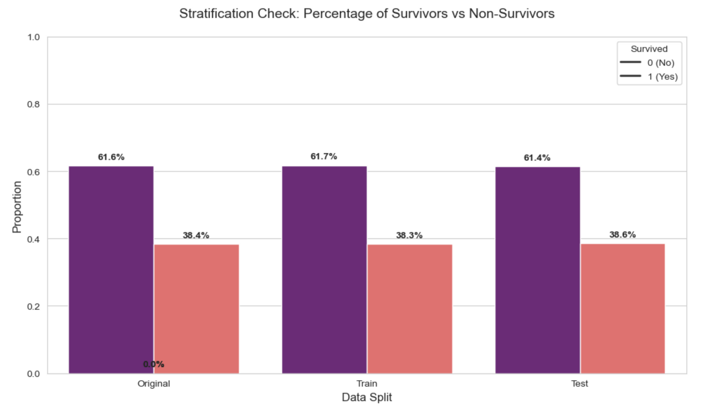
Stratified Splitting

Slide 12
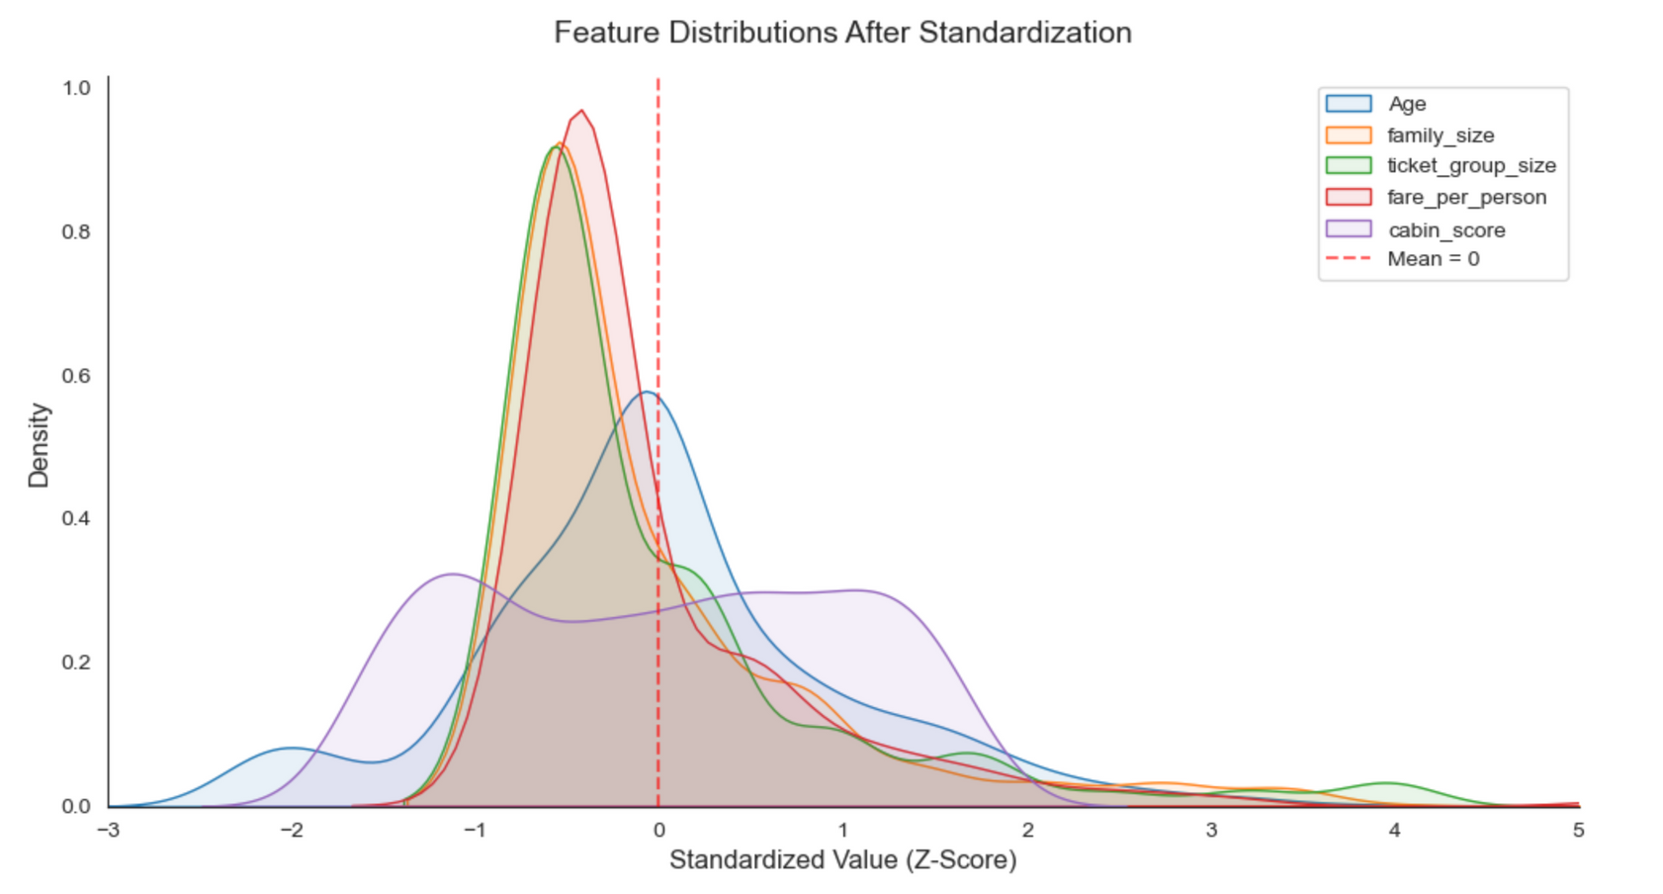
Standardization

Slide 13
Data Modelling

Slide 14

Logistic Regression

Slide 15
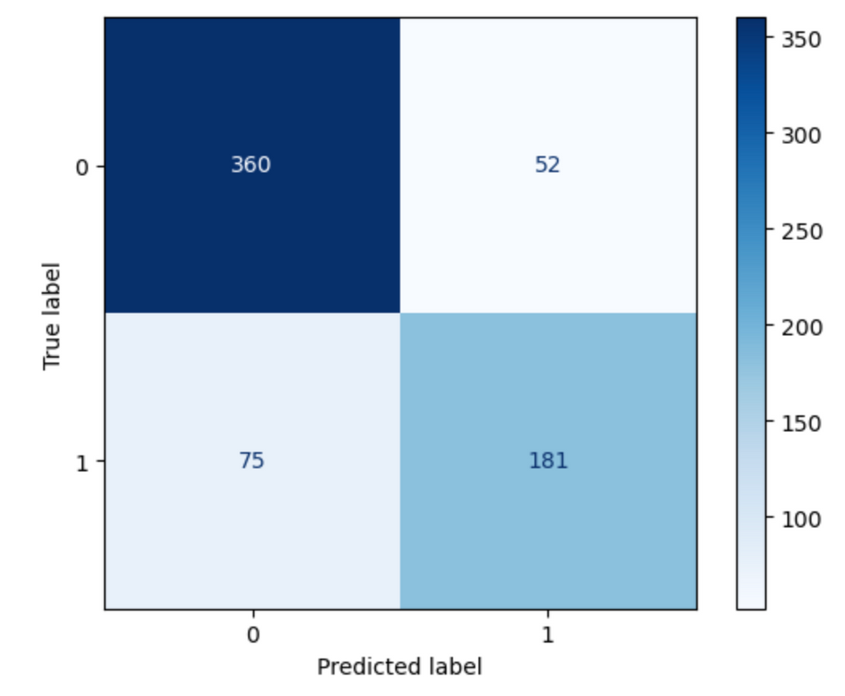
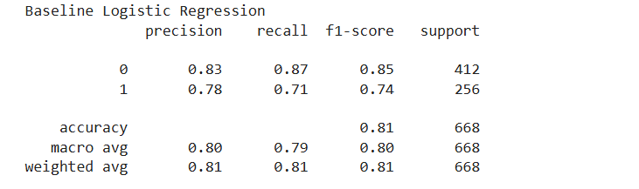
Logistic Regression Baseline

Slide 16
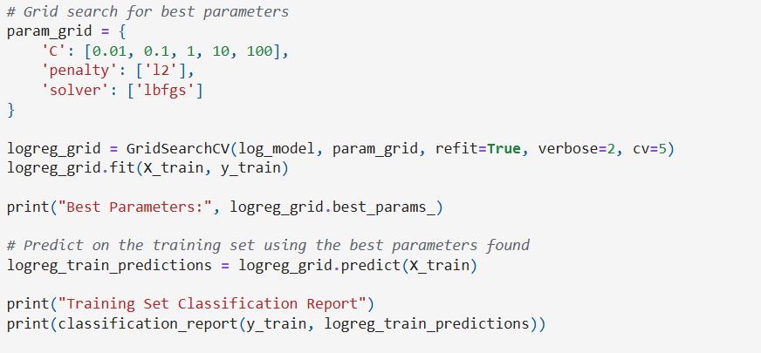
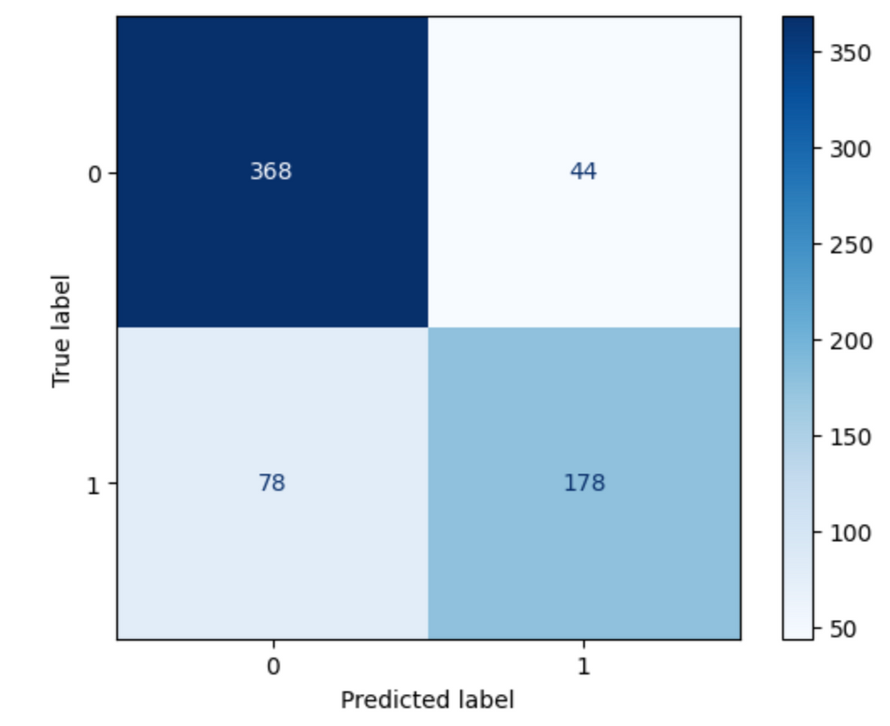
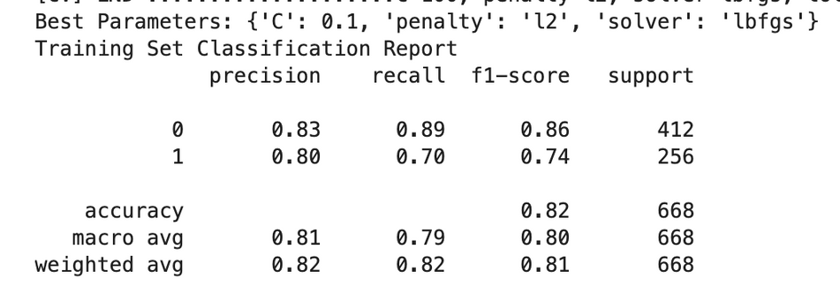
Logistic Regression
Hyperparamter Tuning & 5-fold CV

Slide 17
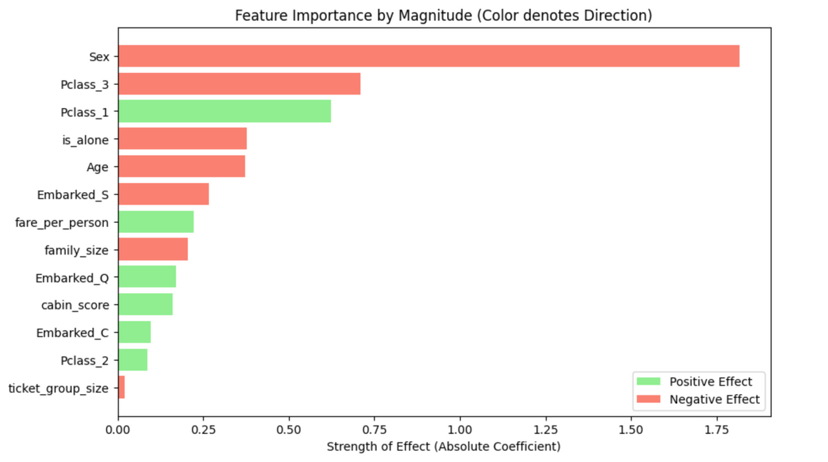
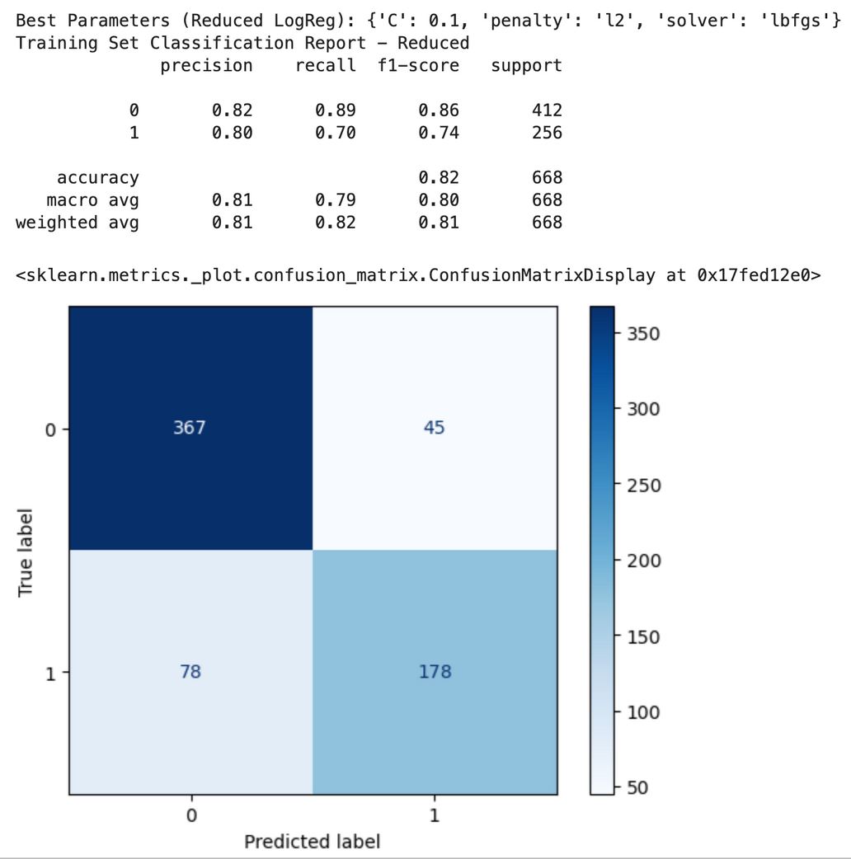
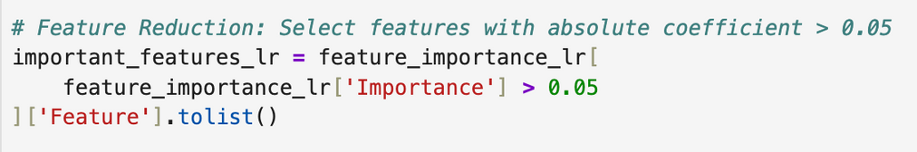
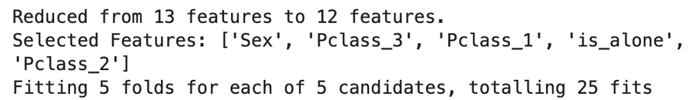
Logistic Regression
Feature Importance Selection & 5-fold CV

Slide 18
Random Forest

Slide 19
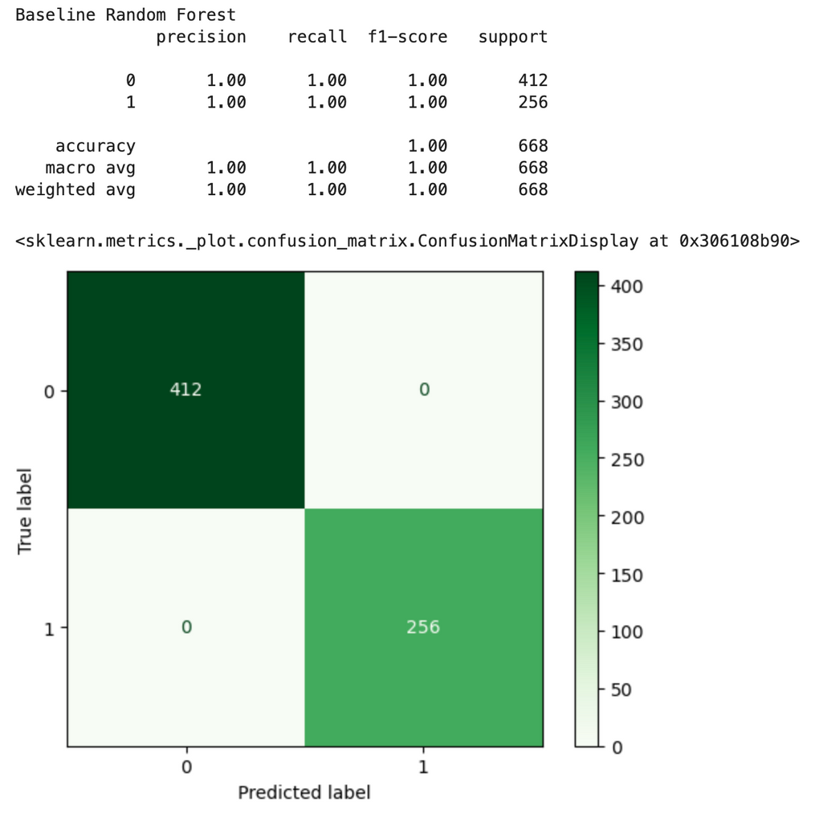
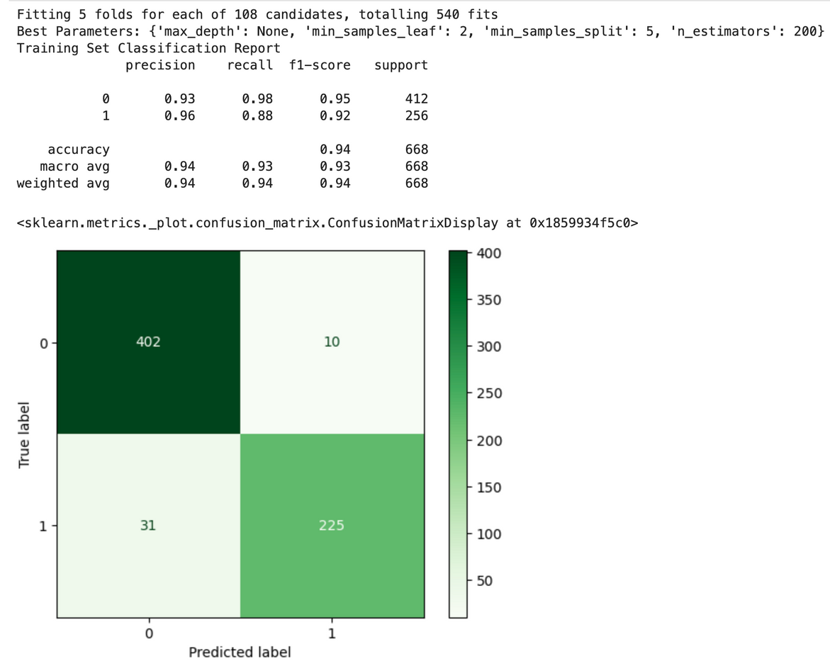

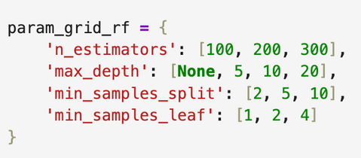
Random Forest

Slide 20
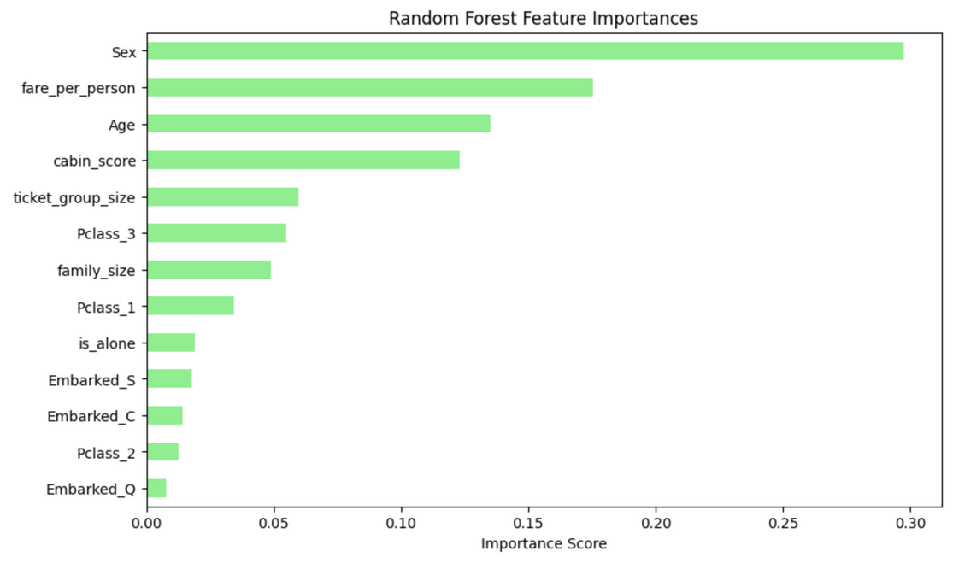
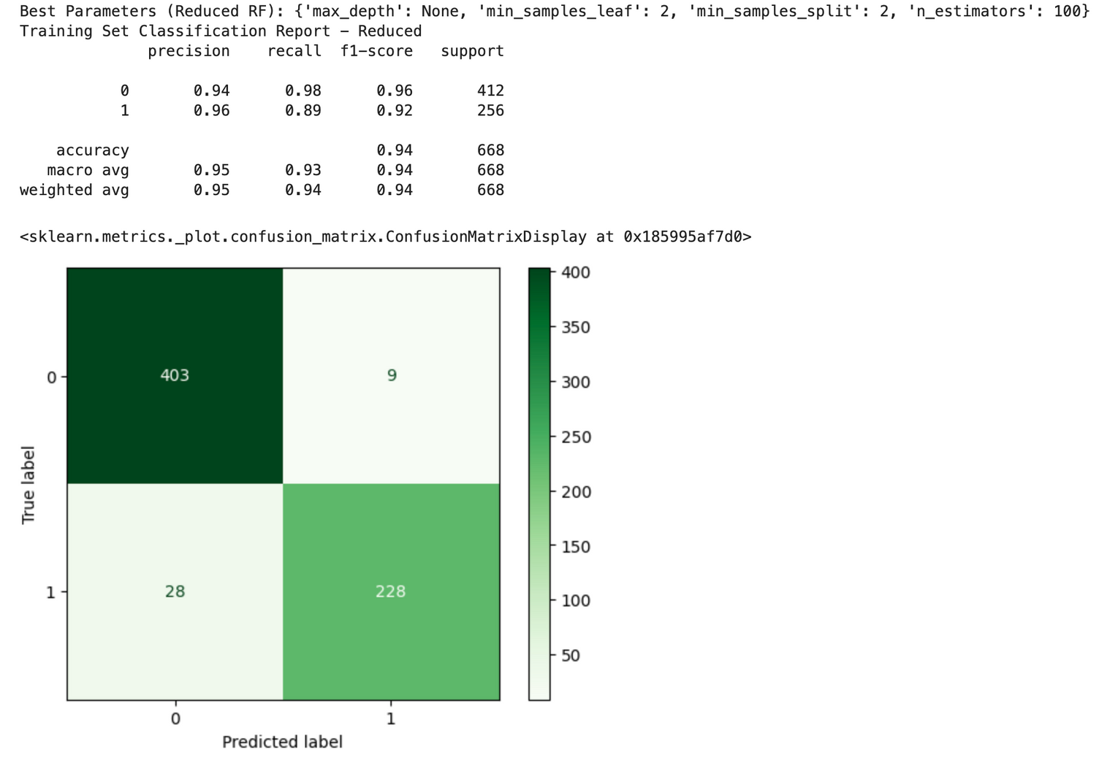
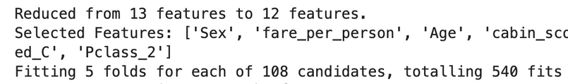
Random Forest
Feature Importance Selection & 5-fold CV

Slide 21
KNN

Slide 22
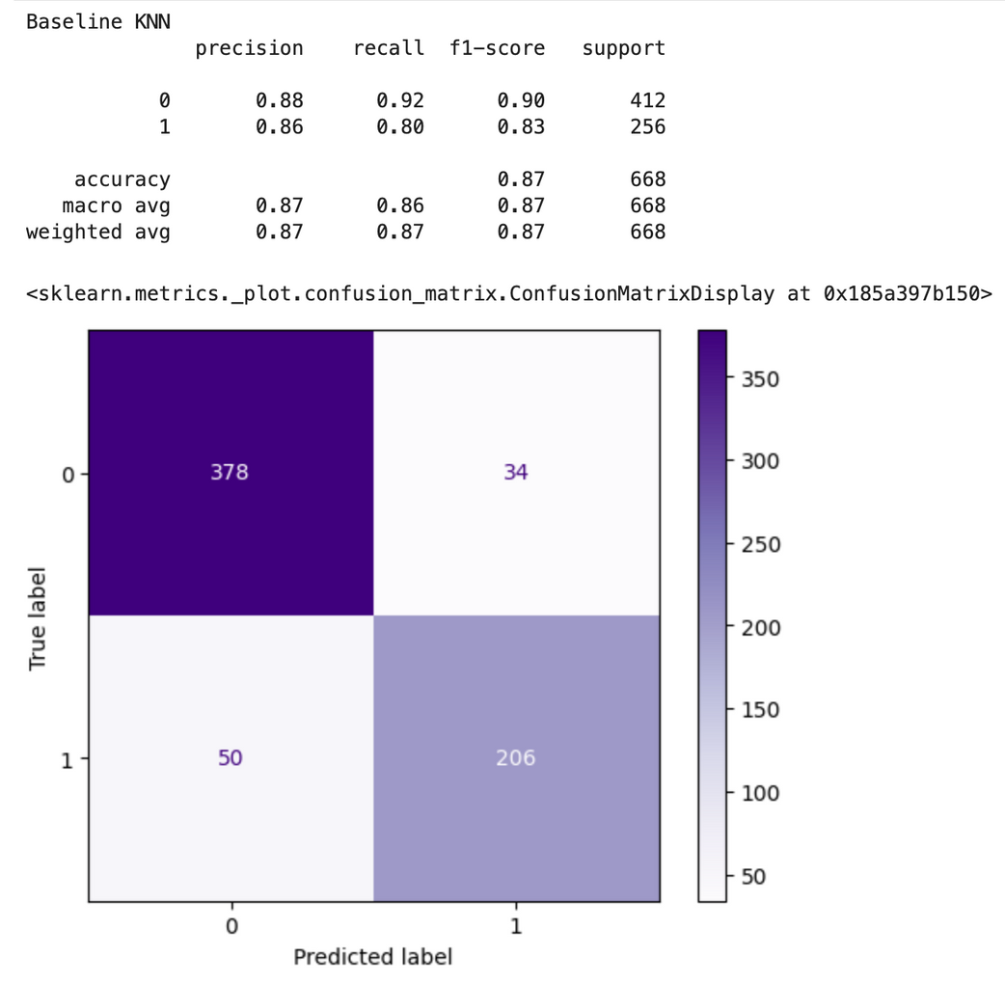
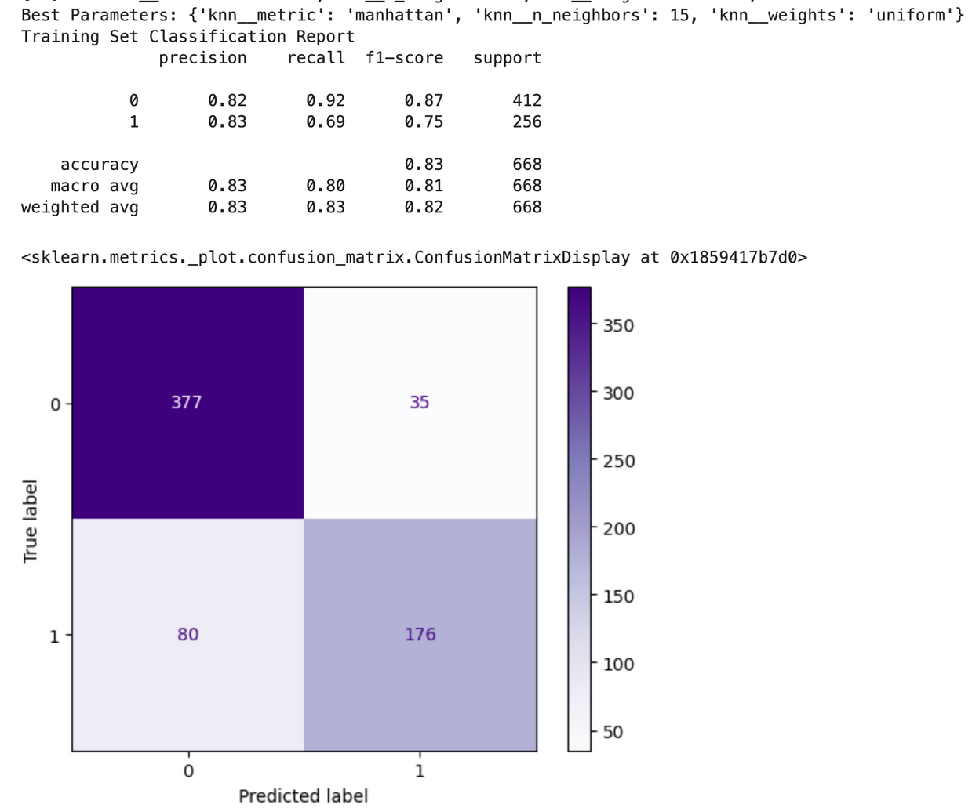
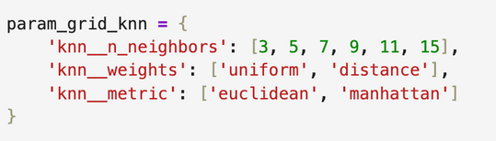
KNN

Slide 23
Data Analysis

Slide 24

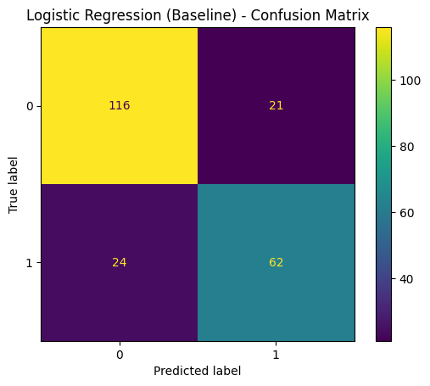
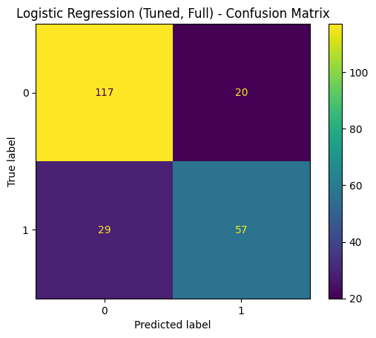
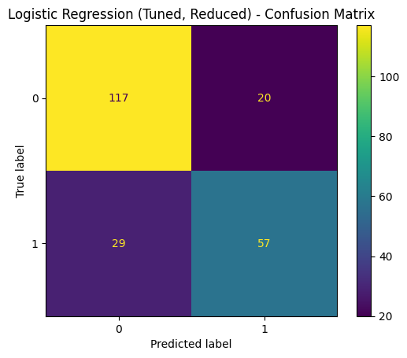
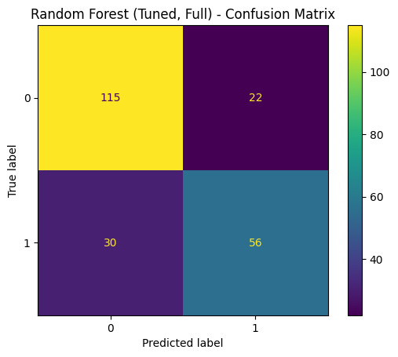
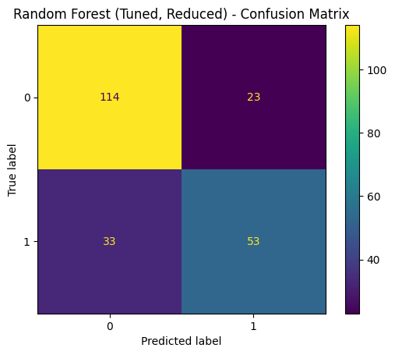
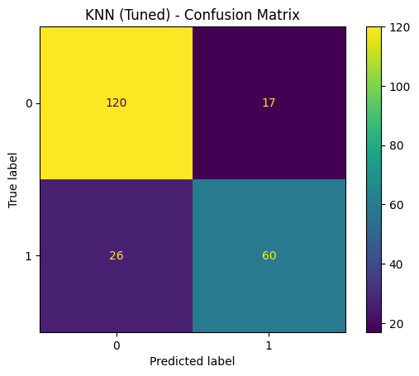
Tuning & Feature Importance
Tuning improves performance compared to the untuned model.
Reduced features keep similar accuracy/F1 while using fewer predictors.
Notes:
On this slide, we show the effect of tuning and feature reduction using confusion matrices.
After hyperparameter tuning, model performance improves compared to the baseline versions.
We also observe that using reduced features keeps accuracy and weighted F1 at a similar level, while using fewer predictors.
This suggests that feature importance helps remove unnecessary information while keeping performance similar.

Slide 25
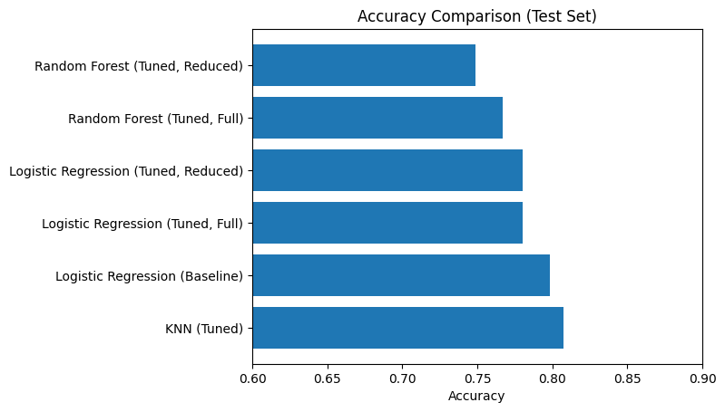
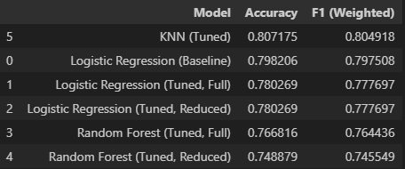
Model Comparison
KNN (tuned) ranks highest on test-set Accuracy and Weighted F1.
Notes:
Here we compare all models on the test set using accuracy and weighted F1-score.
Among these models, tuned KNN achieves the highest accuracy and weighted F1.
Logistic Regression performs slightly lower accuracy, while Random Forest shows moderate performance after tuning.
Based on this comparison, KNN is selected as the best-performing model.

Slide 26
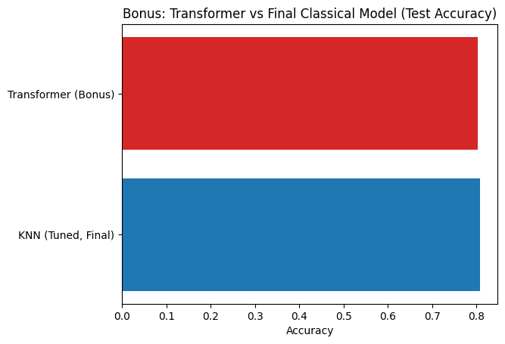
Transformer (Bonus)
Transformer achieves similar test accuracy, shown here as a bonus comparison.
However, due to the relatively small dataset size and higher model complexity, the Transformer is not selected as the final model.
Notes:
This slide shows the Transformer model as a bonus comparison.
The Transformer achieves a test accuracy that is comparable to the best model.
However, due to the relatively small dataset size and higher model complexity, the Transformer is not selected as the final model.
We include it mainly to demonstrate potential performance, rather than for final deployment.

Slide 27

Final Conclusion
The best model is tuned KNN because it achieves the highest test accuracy and weighted F1 in the comparison table.
This indicates that KNN effectively captures local structure in the Titanic dataset.
While Logistic Regression shows stronger stability, KNN is selected as the final model based on its superior test set performance.
The Transformer model is reported as a bonus comparison and is not considered the final selected model.
Notes:
In conclusion,The best model is tuned KNN because it achieves the highest test accuracy and weighted F1 in the comparison table.
This indicates that KNN effectively captures local structure in the Titanic dataset.
While Logistic Regression shows stronger stability, KNN is selected as the final model based on its superior test set performance.
The Transformer model is reported as a bonus comparison and is not considered the final selected model.

Slide 28

Q/A

